Slide 1
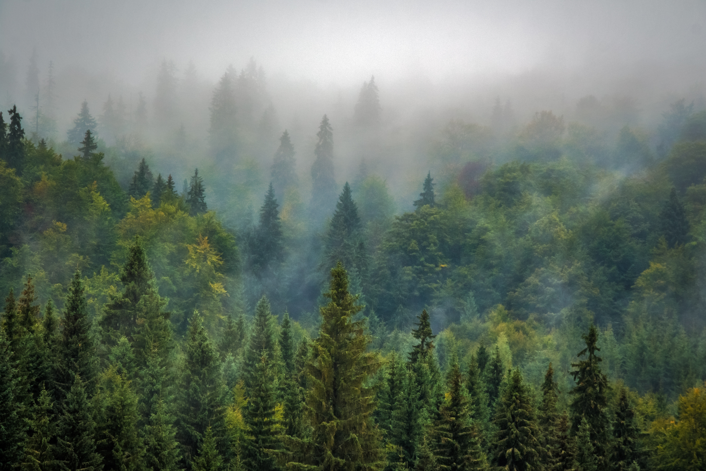

Page 01
Discover Washington
Explore, Experience, and Enjoy!
URL: http://18.118.179.231

Slide 2
Page 02
Meet the Team
Aarushi Kotwani
Role(s): Information Architect (IA), Web Developer, QA
Janani Krishnamurthy
Role(s) Assigned: Server Administrator, Project Manager, Content Creator, QA
Sai Dinesh Kondragunta
Role(s): UX/UI Designer, Content Specialist
Satwik Kunaparaju
Role(s) Assigned: Content Creator, Website Developer
Siva Sushmitha Meduri
Role(s) Assigned: Content Creator, Project Manager, Server Administrator, QA

Slide 3

Agenda
Page 03
Phase 1: The Beginning – Setup & Foundation
Phase 2: The Journey – Expansion & Optimization
Phase 3: The Future – Enhancements & Sustainability

Slide 4
Overview
Page 04
Introduction & Website Purpose – What Discover Washington is about.
Website Design & Content Strategy – Layout, navigation, and theme choices.
Analytics & Key Metrics – GA4 & Looker Studio insights.
Everyday Dashboard & KPI Tracking – How the dashboard helps decision-making.
Action Plan Based on Data Insights – What we are improving.
Team Contributions & Final Thoughts – Summary of work and next steps.

Slide 5

Page 05
Showcasing the natural beauty of Washington, the Evergreen State
Highlighting must-visit places and unique attractions
Exploring what makes Washington special and famous
Serving as a digital guide for visitors and locals
Providing insightful content on cities, nature, food, and culture
Purpose of the Website

Slide 6
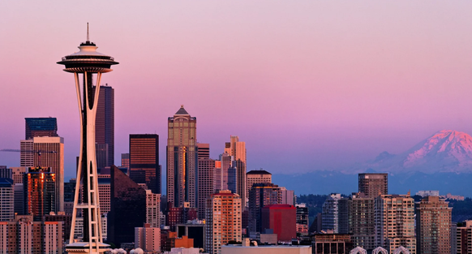
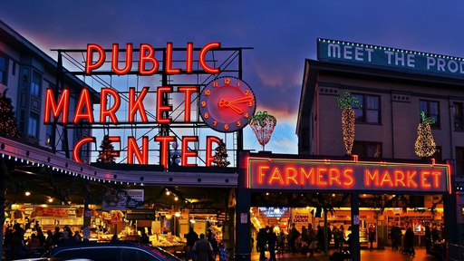
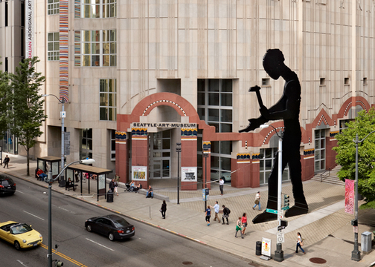
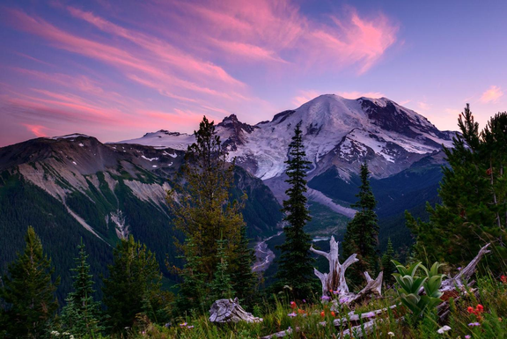
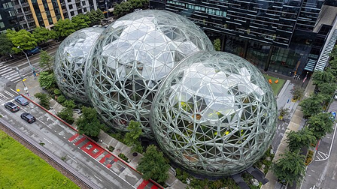
Top Attractions in Seattle
Page 06
Seattle offers a diverse range of attractions catering to all interests. Here are some key categories covered in detail on the website:
Art & Culture – Museums, galleries, and artistic experiences that showcase Seattle’s rich cultural heritage.
Historic Landmarks & Markets – Iconic sites that reflect the city’s history and vibrant local life.
Architectural Marvels – Famous structures offering stunning views and unique experiences.
Science & Innovation – Museums and centers dedicated to aviation, marine life, and technological advancements.
Outdoor & Nature Experiences – Parks, hiking trails, and scenic landscapes that highlight Washington’s natural beauty.

Slide 7
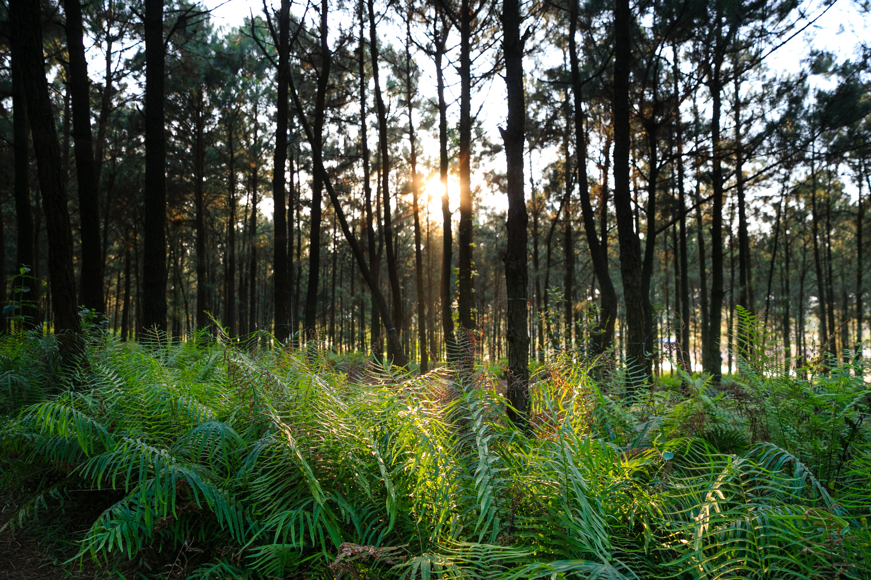
Page 07
Best Times to Visit & Travel Tips
Best Times to Visit
Spring (Mar-May): Mild weather, blooming flowers.
Summer (Jun-Aug): Warm, sunny, peak season.
Fall (Sept-Nov): Cooler, fewer crowds, scenic views.
Winter (Dec-Feb): Cold, perfect for winter sports.
Travel Tips
Public Transport: Use buses, light rail, and ferries.
Weather: Pack layers and waterproof gear.
Local Tip: Explore outdoor attractions, rain or shine!

Slide 8
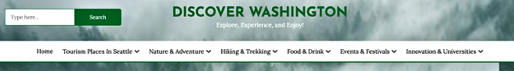
Menu Structure
Page 08
- Home
- Tourism Places in Seattle
- Nature & Adventure
- Hiking & Trekking
- Food & Drink
- Events & Festivals
- Innovation & Universities

Slide 9
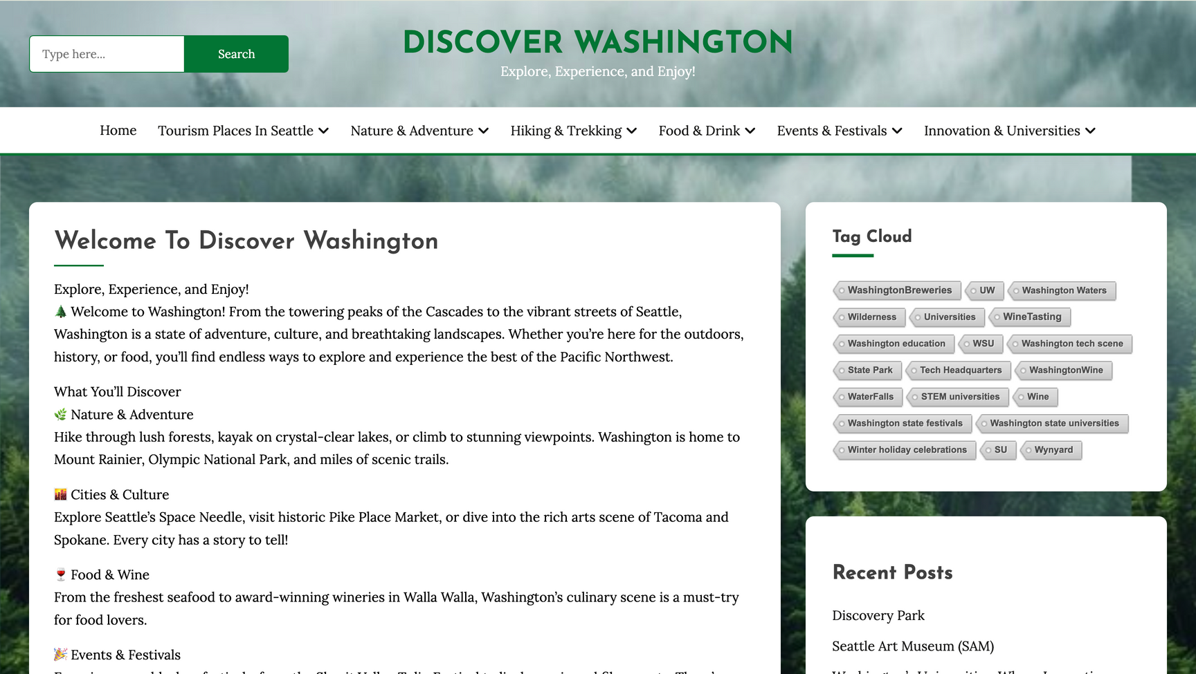
Website Overview
Page 09
The website features a well-organized layout with multiple posts, each categorized for easy navigation.
Posts are tagged with relevant keywords, helping users find specific information quickly.
The structure enhances the user experience by providing seamless access to detailed content on Seattle’s attractions, events, and more.

Slide 10
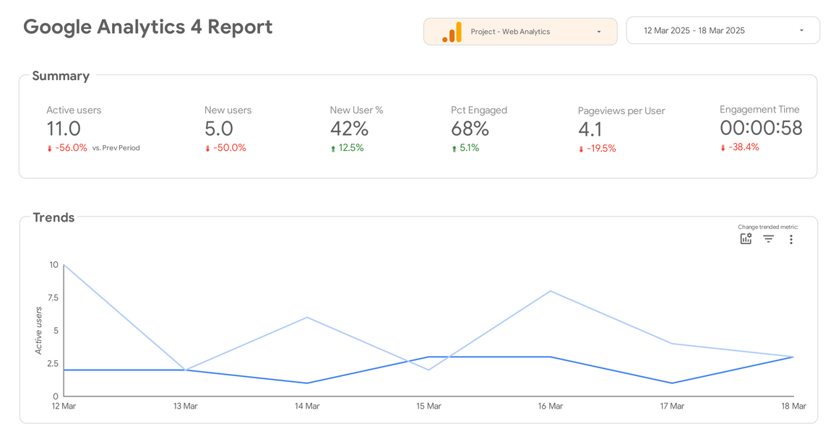
Page 10
Website Performance Overview
Active Users: 11 (↓ 56% from previous period)
New Users: 5 (↓ 50%)
Engagement Rate: 68% (↑ 5.1%)
Average Engagement Time: 58 seconds (↓ 38.4%)
Insight: While engagement has improved slightly, user traffic has decreased significantly, indicating a need for marketing efforts.

Slide 11
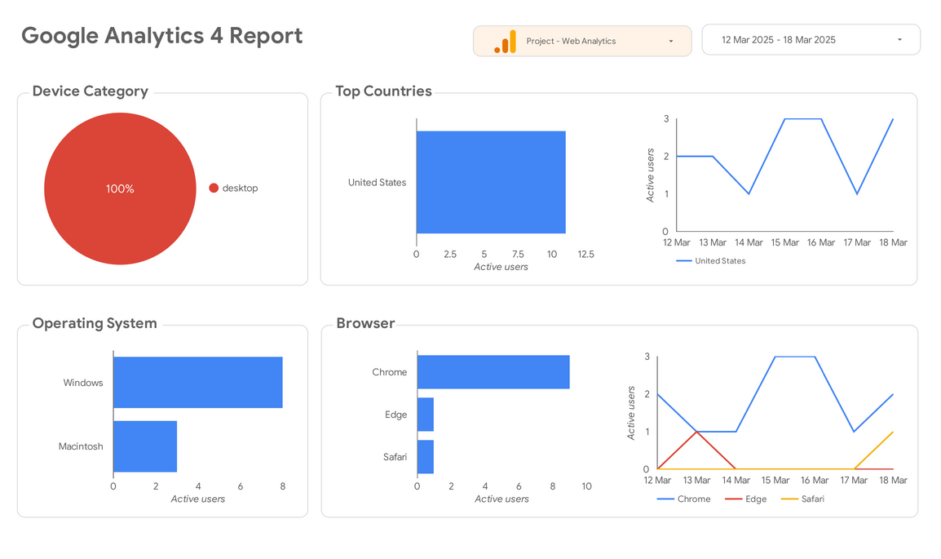
Page 11
Top Countries & Browsers
Majority of users are from the United States → Focus on content tailored to this audience.
Top Browser: Edge, followed by Safari → Ensure compatibility with these browsers.
Insight: Browser preferences suggest users may be using Windows devices more frequently.
100% of users are on Desktop → Ensure the website is desktop-optimized but consider mobile-friendliness for future growth.

Slide 12
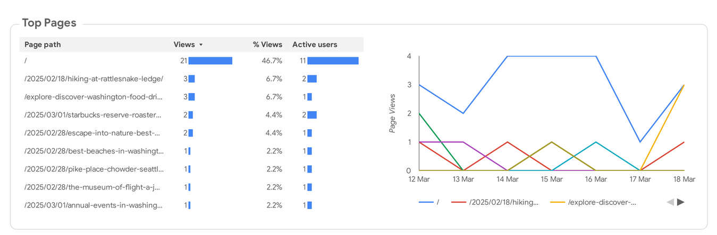
Page 12
User Behavior Insights
Highlight the top-performing pages based on views.
Identify which types of content are attracting the most visitors.
Insight: Focus on optimizing and promoting high-traffic pages while improving underperforming ones.

Slide 13
KPI - Key Performance Indicators
Page 13
1. Visitor Growth
KPI: Total views, new users
Metric: Track user increase over time
2. Engagement
KPI: Bounce rate, engagement rate
Metric: Improve user interaction and time spent on pages
3. User Interaction
KPI: Pages viewed, page engagement
Metric: Analyze navigation patterns to refine content
4. Global Reach
KPI: Visitor locations, sessions per country
Metric: Expand audience globally
Key Goals:
Increase visitors & engagement
Keep bounce rate below 40%
Expand global reach
Goal | KPI | Metrics
Goal-1: Maximize Student Participation | Daily Active Students | Active Users
Goal-2: Improve Resource Engagement | Views per Session | Views per Session
Goal-3: Track Content Effectiveness | Average Session Duration | Average Session Duration
Goal-4: Ensure Consistent Access | Returning Visitor Rate | % Returning Users
Goal-5: Validate Navigation Clarity | Bounce Rate | Bounce Rate

Slide 14
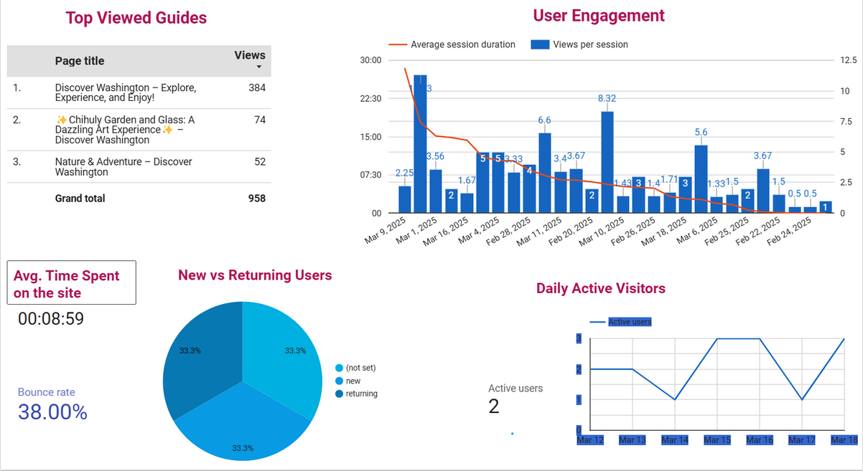
Discover Washington Daily Dashboard
Page 14
Website Analytics Overview
Top Viewed Pages
Discover Washington – Explore, Experience, and Enjoy! (384 views)
Chihuly Garden and Glass (74 views)
Nature & Adventure (52 views)
Total Views: 958
User Engagement
Avg. Time on Site: 8m 59s
Bounce Rate: 38% (Optimal)
Peak Session Views: 8.32 (March 10, 2025)
User Behavior
New vs Returning Users: 33.3% each
Daily Active Users: Peaks on March 15 & 18

Slide 15





Page 15
Conclusion
Data-Driven Enhancements
Google Analytics insights will guide continuous improvements, refining content and user experience based on engagement trends.
User-Centric Approach
Our strategy aligns with visitor behavior, ensuring seamless navigation, optimized content, and enhanced interaction to keep users engaged.
Performance Tracking & KPIs
Focusing on visitor growth, engagement metrics, and retention rates, we aim to create an accessible and immersive platform
Collaborative Effort
A dedicated team has worked to build an intuitive and informative website, integrating interactive features and analytics-driven decisions.
Future Strategies
Moving forward, we will expand content, refine user experience, and enhance global reach, making Discover Washington a top-tier digital guide.

Slide 16
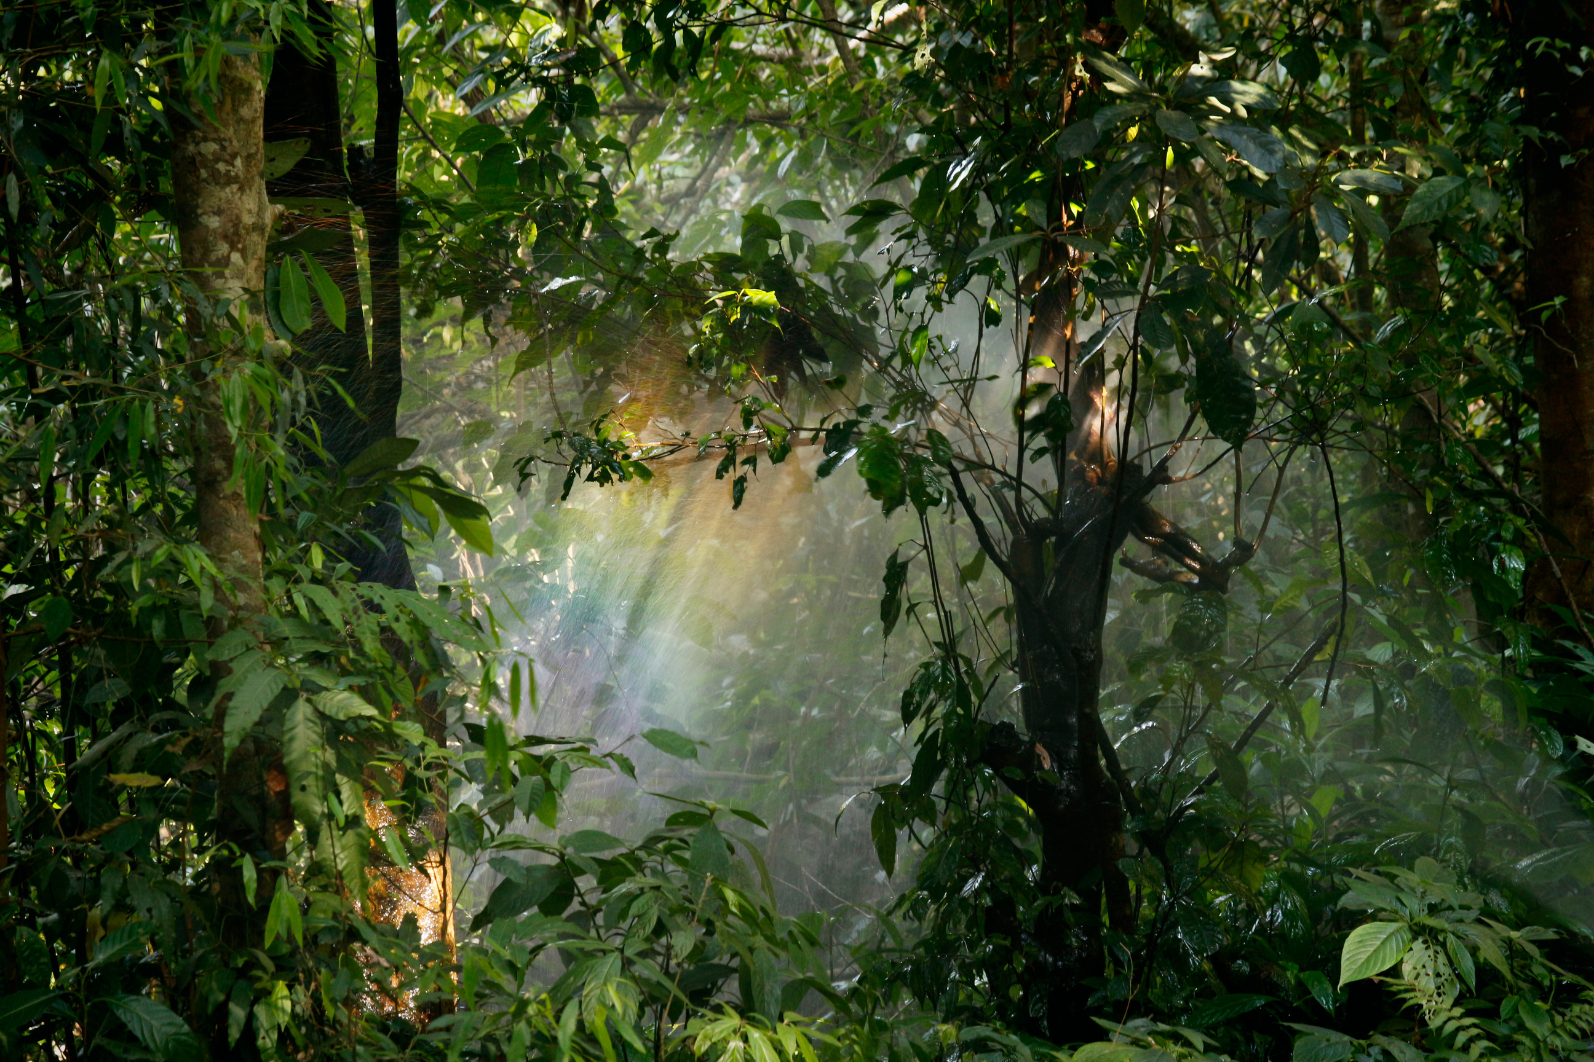
Page 16
Thank You.
t
-

